Slide 1



Deep learning project
Simone Bartucci, Francesco Fazio

Slide 2
Task 1 goals
Metodology
Task 2 goals
Create a neural network capable of predicting the values present in the test dataset.
Studying the accuracy of the model using the MAE metric and evaluating it as the lookback and window shift changes
For this project we considered a methodology used in the implementation of deep learning projects which is based on the CRISP-DM model
The ultimate goal is to determine the presence of anomalies within the test dataset, in particular to recognize signs of Parkinson's in the patients being analyzed.

Slide 3
Task 1: Introduction
We have three columns for the train and test "x,y,z".
The acquisition time for the datasets is 10 seconds.
Lookback ➜ 5 minutes ➜ 30 values for each sequence
Window shift ➜ 10 seconds ➜ Predict the the next value
The three-dimensional tensors considered have the shape:
dim(Time series) = (samples, lookback, number of features)
While the vectors to predict have the shape:
dim(Vectors) =(samples)
There is a one-to-one correspondence between each sequence and the elements of the vector.
This type of structure is called supervised learning.

Slide 4
Task 1 :Understanding and preparing data
We have done a normalization of the data to obtain train data included in the interval [0,1].
We applied the same normalization to the test set.
On the train data, a split is made to obtain a validation set to evaluate the model performance.
Subsequently, was created a generator function that returns the three-dimensional tensors previously mentioned and the related vectors.

Slide 5
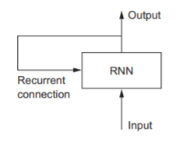
Task 1 : Model (RNN)
A recurrent neural network (RNN) is a category of artificial neural network that includes neurons connected together in a loop. The simplest schematizationof an RNN is the following:
There are several RNN models:
SimpleRNN
LSTM (Long Short-Term Memory)
GRU (Gated recurrent unit)
← Less complex and faster than LSTMs
In this model we have considered:
2 layers GRU (The first with return_sequences = True, activation = 'relu' )
4 layers Dense
optimizer =’adam ’ , loss=’ mse ’ , metrics=[ ’mae ’ ]

Slide 6
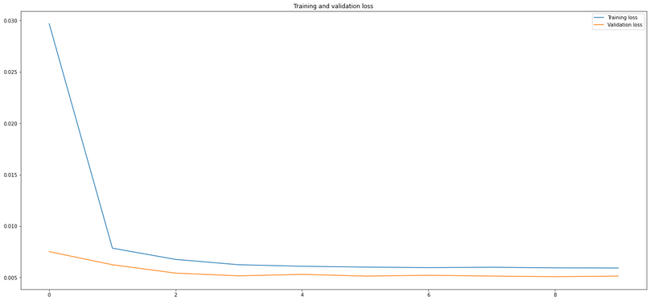
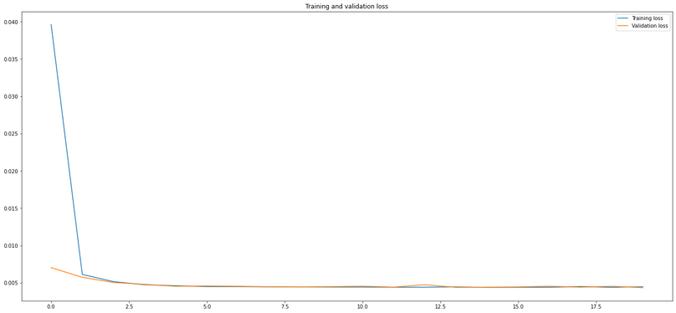
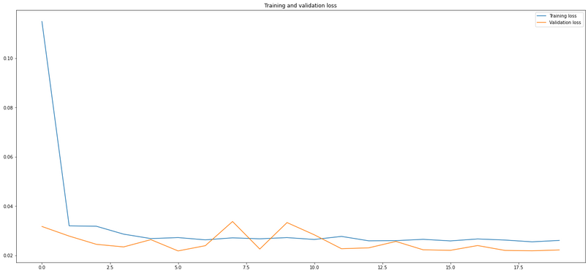
Task 1 : Model evaluation
We report the Training Loss and Validation Loss trends for the three temporal sequences as a function of the epochs:
Training Loss e Validation Loss z
Training Loss e Validation Loss y
Training Loss e Validation Loss x
There is no overfitting or underfitting, this implies that the model learns and determines weights correctly.
The models reache the optimal configuration of the weights after a very few epochs and in the following epochs, this configuration remains almost unchanged. Infact the training loss decreases rapidly after a single epoch, and then continues to vary but slightly compared to the first decrease.

Slide 7
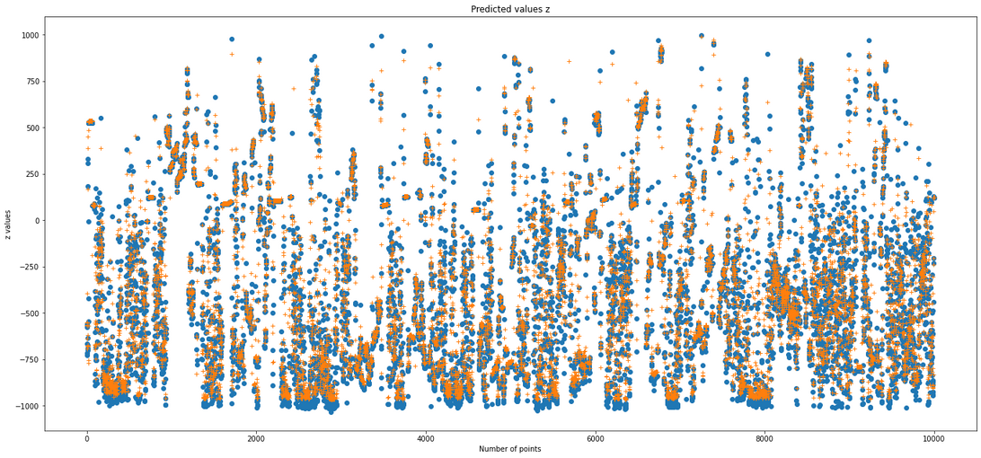
Task 1 : Data analysis
Once the model was built and the network trained, it was possible to apply the model to the time series obtained from the test data to predict the subsequent values of each sequence. The data analysis of the first task can be divided into three points:
Test MAE Analysis
Test MAE Analysis of one of the test time series as the lookback changes
Test MAE Analysis of one of the test time series as the window shift changes
Test MAE Analysis
The result obtained for the three sequences is the following:
Test_MAE_x=81.00
Test_MAE_y=83.38
Test_MAE_z=79.86
As an example, we report the graph that shows the
trend of the predicted values compared to the actual
ones in the case of "z" (for visualization reasons we
consider only the first 10,000 points).

Slide 8
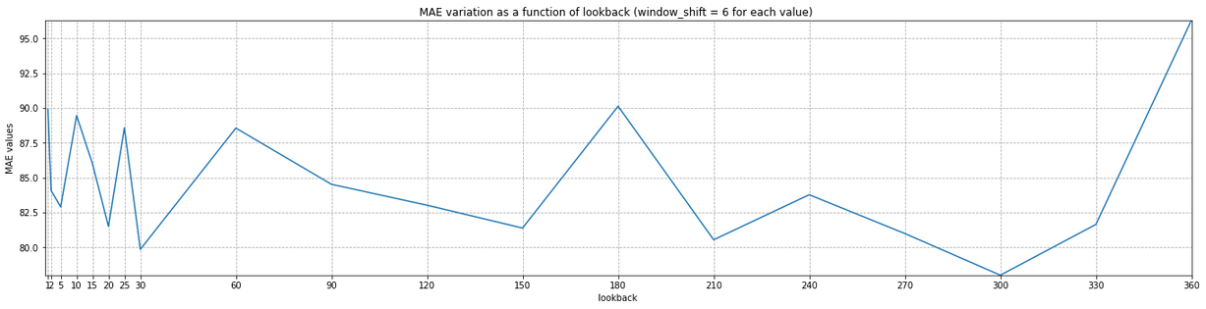
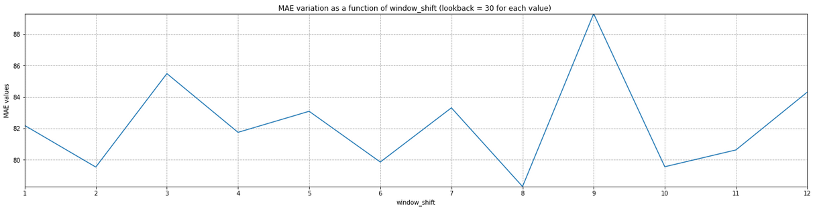
Test MAE Analysis of one of the test time series as the lookback changes
For this analysis, considering the "z" and keeping the window shift value = 6 fixed, the MAE value was determined for a series of lookback values.
Test MAE Analysis of one of the test time series as the window shift changes
Considering the "z" and keeping the lookback value = 30 fixed, the MAE value was determined for a series of window shift values.
In both cases is not possible to identify a trend of growth or decrease of the MAE.

Slide 9
Task 1 : Final remarks
In summary, test and train data were processed:
normalizing them
creating time series with window shift = 6 and lookback = 30
creating the relative vectors inherent to the next data to be predicted
Subsequently, was created and trained a model that has 2 RNN and 4 Dense layers.
It is possible to observe that the model is able to learn the main characteristics of each train time series after a very few epochs, finding the optimal weights already in the second epoch.
Analyzing the training loss and validation loss graphs, it can be observed that there are no underfittings and overfittings.

Slide 10
By determining the MAE for each column of the test dataset, it was observed that these are lower than the reference ones provided.
Test_MAE_x= 81.00 < 81.06
Test_MAE_y= 83.38 < 85.26
Test_MAE_z= 79.86 < 79.94
This last evidence is what allows us to affirm that the treatment carried out can be considered satisfactory.
As a second point, the way in which lookback and window shift modify the performance of the model and therefore the test MAE was evaluated.
The results in both cases showed that it is not possible to identify upward or downward trends.

Slide 11
Task 2: Introduction
We have seven columns for the train and test :
Patient;
Accelerometer that reads the values given by the three axes (x, y, z);
Heart rate;
Sampling date and time.
"OFF Periods" are the time intervals in which the symptoms of Parkinson's return.
These are the anomalies that will be searched.
In the train dataset we have healthy patients, in the test dataset sick patients.
Also in this case we have three-dimensional tensors , but we don't have their reference vectors:
we don't have to predict values, but understand if they are anomalies or not.
This type of structure is called unsupervised learning.

Slide 12
Task 2 :Understanding and preparing data
Two lists have been defined, the first containing the patients analyzed, the second the indices referring to the end of the data collection for each patient. This was done to divide the test data and consider the patients individually.
On the train data, the lines associated with "Heart Rate=-1" have been deleted (missing data).
Test data are acquired every 10 seconds while the train data are acquired every second.
To eliminate this difference, the train data was averaged every 10 values, rescaling the dataset by a value of 10.
A normalization of the data was then carried out to rescaling them in the interval [0, 1].
Once this was done, it was possible to construct the time series used in the model using:
lookback ➜ 60
window shift ➜ 1

Slide 13
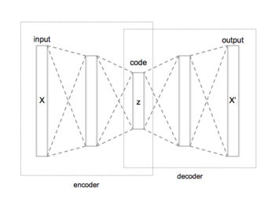
Task 2 : Model (AUTOENCODER)
An autoencoder aims to replicate the input data.
In output we have a copy of the data after having analyzed and reconstructed them without supervision.
The data in an autoencoder are not directly mapped from the input to the output, so the network does not just copy the input data.
There are three components in an autoencoder:
an encoding part (input)
a data handling component (or bottleneck)
a decoder part (output)
The network is trained on the encoded data and produces
a recreation of that data. In this way the network learns the most
important characteristics of the input data.

Slide 14
For this model we have:
1 layer GRU
4 layers Dense
1 layer "RepeatVector"
4 layers Dense
1 layer GRU
1 layer TimeDistributed
optimizer =keras.optimizers.Adam( learningrate=0.001), loss= 'mae'
}
← Encoder
← This layer has two-dimensional dimension tensors (samples, number of features) as input and returns a three-dimensional dimension tensor (samples, lookback, number of features).
}
← Decoder
← This layer is applied to get back an output of the same size as the initial one.

Slide 15
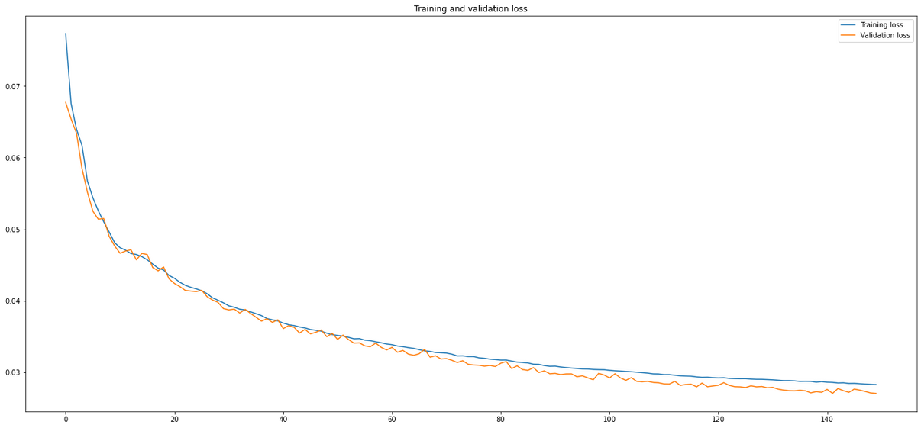
Task 2 : Model evaluation
We report the Training Loss and Validation Loss trend as a function of the epochs:
In this case we have considered 150 epochs. This choice is justified by the fact that we don't have an immediate convergence, but the training loss and validation loss continue to decrease, so is necessary to increase the epochs. The process is stopped when the slope of the two training and validation curves tends to be zero and consequently learning is much slower and ineffective as it is close to a local minimum. Also in this case we don't have overfitting or underfitting.

Slide 16
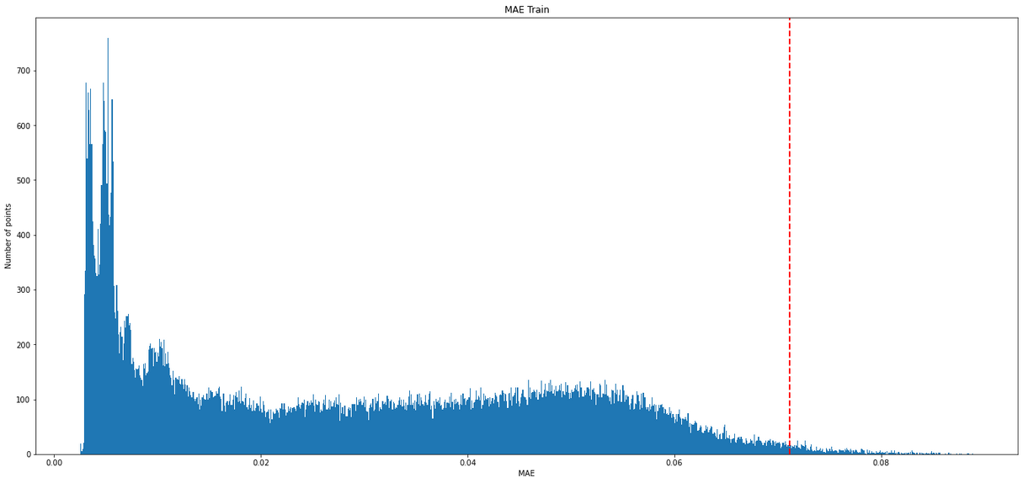
Task 2 : Data analysis
For the second task we focused on the investigation of anomalies.
We started by applying the model to the train data and obtaining the MAE.
To obtain a single MAE value for each row of the 4 columns "x"," y", "z" and "Heart Rate", a reshape was performed, obtaining two-dimensional tensors. The same procedure was followed for the patients in the Test.
A threshold value was then determined as a function of the maximum of the train MAE, such as 80% of the maximum of the train MAE. This is the threshold value considered.

Slide 17
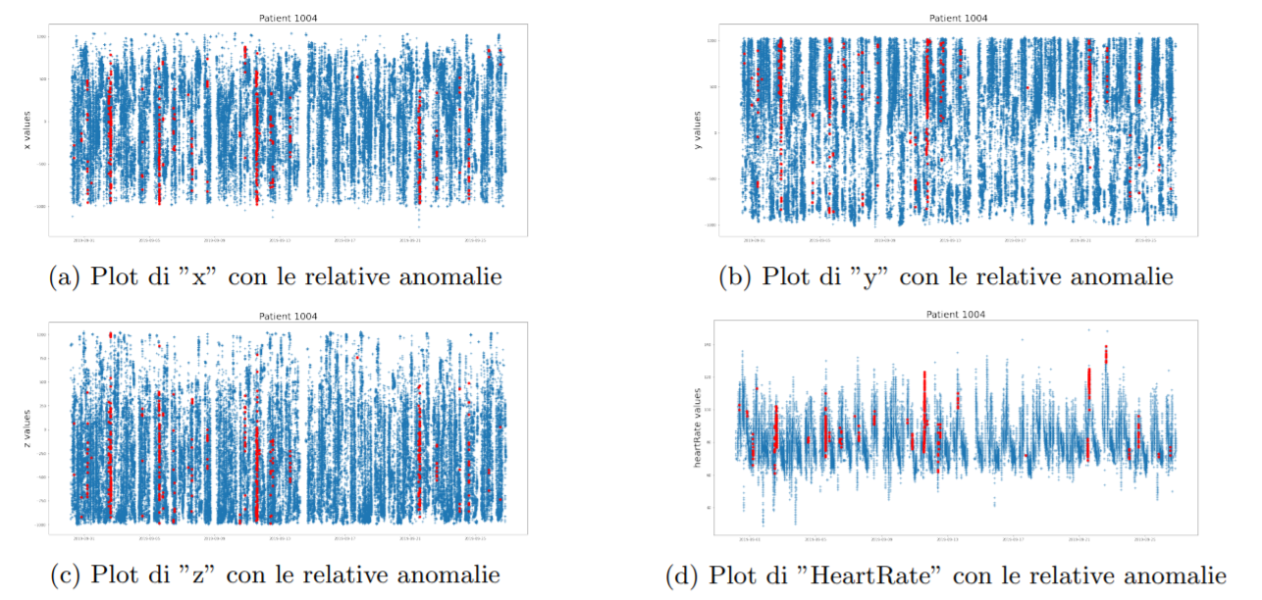
After applying the model to the Test data, the indices associated with a MAE value higher than the threshold value have been cataloged as anomalies. The table shows the number of anomalies found for each patient:
Once this was done, it was possible to graph the data for each patient and the relative anomalies.
We report the results obtained for one of the patients analyzed, the patient 1004:

Slide 18
Task 2 : Final remarks
After removing the lines associated with "Heart Rate= -1 ", the train data was reprocessed in order to obtain sampling intervals of 10 seconds. This was done by averaging every 10 seconds.
It was then possible to carry out a normalization of the datasets.
The main objectives of the following task did not focus on predicting the next value of a sequence, but on determining anomalies associated with the OFF periods in the test data.
To do this, has been created a model using an autoencoder containing GRU and Dense layers.
The train data are assumed to be free from anomalies, so using the latter it is possible, in principle, to create a model that can correctly reconstruct only non-anomalous data.

Slide 19
Following this consideration, the model was used to reconstruct the train data, in order to choose the threshold value.
The last operation was to apply the model to the test data, saving all the values that, when reconstructed, have an MAE higher than the threshold value.
In this context it was finally possible to determine the OFF periods.
The discussion for this problem and the considerations are more elaborate than the first task.
In fact, it is not possible to understand whether an anomaly, once determined, is actually associated with an OFF period, a bad model reconstruction or an inappropriate choice of the Threshold.

